Slide 1
DIMENSIONS OF BUSINESS ENVIRONMENT
BY: DR. RITU CHANDNA
ASSOCIATE PROFESSOR IN COMMERCE
SMS KHALSA LABANA GIRLS COLLEGE, BARARA

Slide 2
BUSINESS ENVIRONMENT IS THE SUM TOTAL OF ALL EXTERNAL AND INTERNAL FACTORS THAT INFLUENCE A BUSINESS. KEEP IN MIND THAT EXTERNAL FACTORS & INTERNAL FACTORS CAN INFLUENCE EACH OTHER AND WORK TOGETHER TO AFFECT A BUSINESS.

Slide 3
BUSINESS ENVIRONMENT IS A DIRECT RELATIONSHIP BETWEEN SUCCESSFUL MANAGEMET AND THE INFLUENCE AND IMPACT OF ENVIRONMENTAL CHANGE

Slide 4
FACTORS AFFECTING BUSINESS ENVIRONMENT

Slide 5
INTERNAL BUSINESS ENVIRONMENT
EXTERNAL BUSINESS ENVIRONMENT
FORCES WHICH AFFECT A ORGANIZATION’S FIRM OR BEHAVIOUR.
EXAMPLES ARE LIKE PERSONEL, FINANCE,MARKETING, PRODUCTION, OPERATIONAL RESEARCH & SO ON
EXTERNAL BUSINESS ENVIROMENT IS A SET OF POLITICAL . ECONOMIC , SOCIAL AND TECHNOLOGICAL (PEST) FORCES THAT ARE LARGELY OUTSIDE THE INFLUENCE OF A BUSINESS, AND THAT CAN HAVE POSITIVE AND NEGATIVE IMPACT

Slide 6
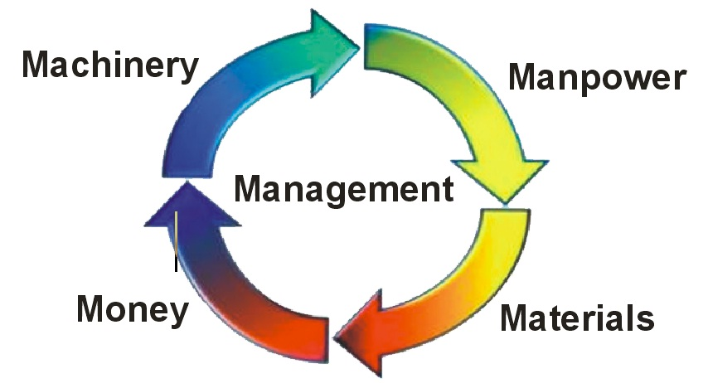
INTERNAL BUSINESS ENVIRONMENT –
5 M’S OF MANAGEMENT

Slide 7
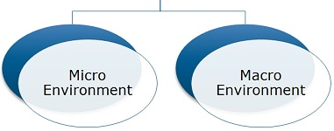
EXTERNAL BUSINESS ENVIRONMENT

Slide 8
MICRO ENVIRONMENT IS THE ENVIRONMENT THAT AN ORGANIZATION CAN INFLUENCE. IT MAY NOT BE ABLE TO CORRECT ALL FLAWS IN THE MICROENVIRONMENT, BUT IT HAS A MUCH BETTER CONTROL OVER THE MACRO ENVIRONMENT.

Slide 9
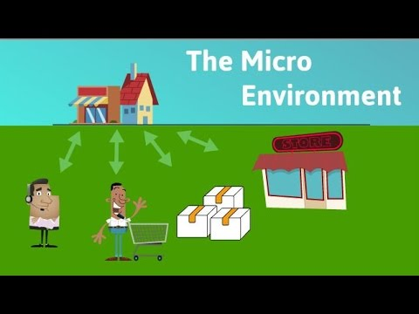
FACTORS INFLUENCING MICRO ENVIRONMENT
SUPPLIERS
CUSTOMERS
MARKET INTERMEDIARIES
COMPETITORS

Slide 10
MICRO ENVIRONMENT OF BUSINESS
1. SUPPLIERS
SUPPLIERS SUPPLY RAW MATERIALS AND OTHER COMPONENTS (INPUTS)
IMPORTANCE RELIABLE SUPPLY – CONTINUOUS SUPPLY FOR SMOOTH FUNCTIONING.

Slide 11
MICRO ENVIRONMENT OF BUSINESS
CUSTOMERS
(CATEGORIES)
INDUSTRIAL CUSTOMERS
WHOLESALE CUSTOMERS
RETAIL CUSTOMERS
GOVERNMENT CUSTOMERS
FOREIGN CUSTOMERS

Slide 12
MICRO ENVIRONMENT OF BUSINESS
MARKET INTERMEDIARIES
MIDDLEMEN
PHYSICAL DISTRIBUTION FIRMS : (WAREHOUSES AND TRANSPORT FIRMS)
MARKETING SERVICE AGENCIES (ADVERTISING AGENCIES, MARKET RESEARCH FIRMS, MEDIA FIRMS, CONSULTING FIRMS)
FINANCIAL INTERMEDIARIES

Slide 13
MICRO ENVIRONMENT OF BUSINESS
COMPETITORS
THREAT OF ENTRY OF NEW FIRMS
POWER OF BUYERS
POWER OF SUPPLIERS
POWER OF SUBSTITUTES

Slide 14
MACRO ENVIRONMENT ARE MAJOR EXTERNAL AND UNCONTROLLABLE FACTORS THAT INFLUENCE AN ORGANIZATION’S DECISION MAKING, AND AFFECT ITS PERFORMANCE AND STARTEGIES

Slide 15
MACRO ENVIRONMENT
FACTORS INFLUENCING MACRO ENVIRONMENT
ECONOMIC ENVIRONMENT
SOCIAL ENVIRONMENT
TECHNOLOGICAL ENVIRONMENT
POLITICAL ENVIRONMENT
LEGAL ENVIRONMENT

Slide 16
MACRO ENVIRONMENT OF BUSINESS
ECONOMIC ENVIRONMENT
ECONOMIC CONDITIONS
ECONOMIC POLICIES
OTHER ECONOMIC FACTORS

Slide 17
MACRO ENVIRONMENT OF BUSINESS
SOCIAL ENVIRONMENT
SOCIAL FORCES LIKE ATTITUDE OF PEOPLE TO WORK
FAMILY SYSTEM
CASTE SYSTEM
RELIGION, EDUCATION
URBANISATION
CUSTOMS & TRADITIONS

Slide 18
MACRO ENVIRONMENT OF BUSINESS
TECHNOLOGICAL ENVIRONMENT
TECHNOLOGY IS ABOUT APPLICATION OF TOOLS, METHODS AND TECHNIQUES TO IMPROVE PRODUCTION AND PROCESSES. TECHNOLOGY IS LIFE FOR GROWTH AND COMPETITIVENESS OF BUSINESS

Slide 19
MACRO ENVIRONMENT OF BUSINESS
POLITICAL ENVIRONMENT
POLITICAL IDEOLOGY OF GOVERNMENT
POLITICAL STABILITY IN COUNTRY
RELATIONS OF OUR NATION WITH OTHER COUNTRIES
WELFARE ACTIVITIES OF GOVERNMENT
CENTRE-STATE RELATIONSHIP

Slide 20
MACRO ENVIRONMENT OF BUSINESS
LEGAL ENVIRONMENT
LEGAL ENVIRONMENT HAS A PERMANENT AND LASTING IMPACT IN SHAPING BUSINESS. THER ARE FEW LEGAL FACTORS SUCH AS CO-ACT 1956, IDRA 1951, FEMA, EXIM POLICY, FACTORIES ACT 1948, TRADE UNION ACT 1926.

