Slide 1
Fiscal Policy of India
Class - B.COM(Final)
Subject – Business Environment
Presented by :- DR. Ritu Chandna

Slide 2
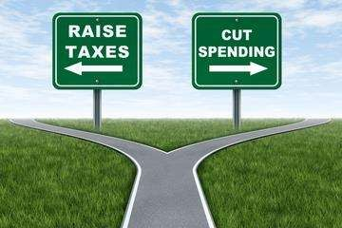
Fiscal Policy
The word Fisc means ‘state treasury’ and fiscal policy refers to policy concerning the use of state treasury or the govt. finance to achieve the macroeconomic goals.
The fiscal policy is concerned with the raising of government revenue and incurring of government expenditure.

Slide 3
Objectives of Fiscal Policy
Development by effective mobilization of resources
Effective allocation of Financial Resources
Reduction in inequalities of Income and Wealth
Price stability and Control of Inflation
Employment Generation
Capital Formation
Development of Infrastructure

Slide 4
Budget
An estimation of the revenue and expenses over a specified future period of time
Budget refers a financial statement which shows anticipated revenue and anticipated expenditure in an accounting year

