Slide 1
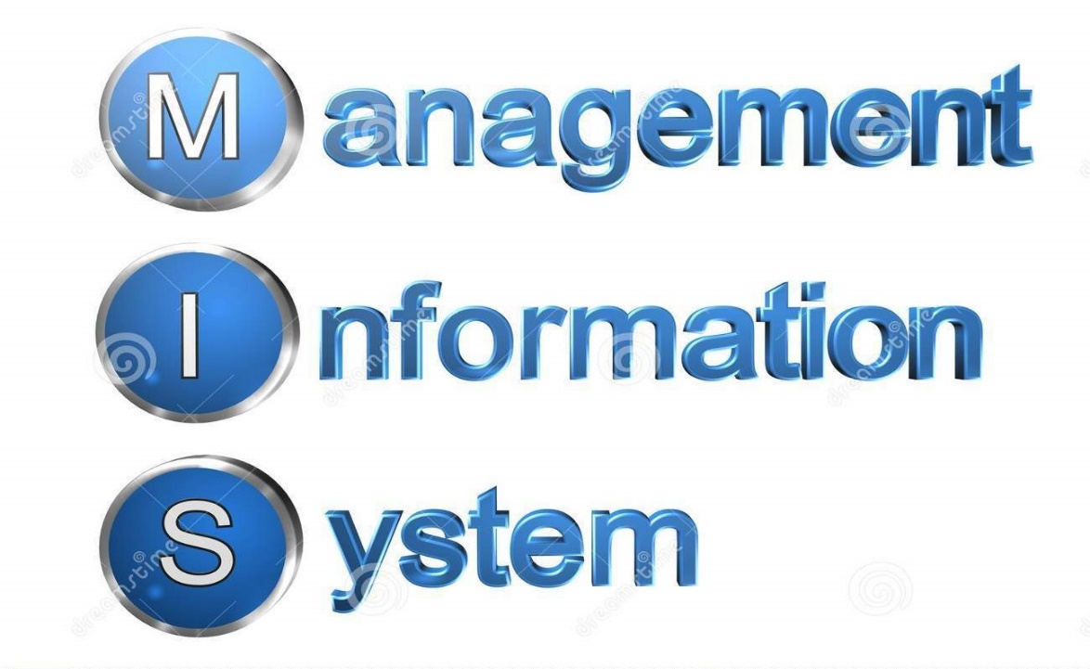
MANAGEMENT INFORMATION SYSTEM (MIS) COURSE – B.COM(FINAL)
MANAGEMENT ACCOUNTING
Presented By : DR. RITU CHANDNA

Slide 2
What is MIS ?
Management Information System is a computer based information system which is basically concerned with processing data into information which is then communicated to the various departments in an organization to support the operations, the management and the decision making function in the organization.

Slide 3
Definition of MIS
Management information system, or MIS, broadly refers to a computer based system that provides managers with the tools to organize, evaluate and efficiently manage departments within an organization
- Subhalakshmi Joshi

Slide 4
What does Management Information System (MIS) mean?
Fig. 1.1–Management Information System by Sunitha Vanze

Slide 5
MANAGEMENT
MANAGEMENT is the effective utilisation of human and material resources to achieve the enterprise objective
It is a process consisting of the five basic functions:
1 Planning
2 Organising
3 Staffing
4 Directing
5 Controlling

Slide 6
INFORMATION
Information: Information, in MIS, means the processed data that helps the management in planning, controlling and operations.
Data means unstructured raw facts, observations or unevaluated messages in isolation. Data involves facts and figures. Information on the other hand is like a finished product.
6

Slide 7
DATA V INFORMATION
SM001 North P001 475
SM002 East P002 500
………
Salesman Code Zone It SM001 North |  | em Code P001 | Sales 475
SM002 | East | P002 | 500
……………………….
Data
Processing
Information
Fig 1.2- Management Information System by Dr.P.Mohanan
7

Slide 8
SYSTEM
. A system is an orderly grouping of interdependent components linked together according to a plan to achieve a specific objective.
. Human body is a system composed of various parts, which are working together towards a common objective , that is to live

Slide 9
Information System
An information system is an organized combination of people, hardware, software, communications network, and data resources that collects, transforms, and disseminates
in an organization.

Slide 10
Components of Information System
Input
Processor
Output
People
Hardware(physical devices)
Software (information processing instructions)
Data
Network (communication channels)

Slide 11
Management Information System
A management Information System is
An integrated user-machine system
For providing information
To support the operations, management, analysis, and decision-making functions
In an organization
The system utilizes
Computer Hardware and Software
Manual Procedures
Models for analysis, planning, control and decision making and
A database

Slide 12
Why MIS ?
Manager makes decisions all the time.
There is an overload of information.
All information is not useful.
Anything which helps manager improve his decision-making will obviously lead to better result.
MIS is a system, where data is the input, which is processed to provide output in the form of information reports, summaries, etc . Which aid the manager’s decision-making process.

Slide 13
Types of Management Information Systems
Executive Support Systems ("ESS") -designed to help senior management make strategic decisions. ESS typically involve lots of data analysis and modeling tools to help strategic decision-making.
Decision-support systems ("DSS")-specifically designed to help management make decisions in situations where there is uncertainty about the possible outcomes of those decisions.
Knowledge Management Systems ("KMS")-to help businesses create and share information. These are typically used in a business where employees create new knowledge and expertise - which can then be shared by other people in the organization to create further commercial opportunities.
13

Slide 14
Types of Management Information Systems Cont…..
Transaction Processing Systems ("TPS")-designed to process routine transactions efficiently and accurately. Managers often use these systems to deal with such tasks as payroll, customer billing and payments to suppliers.
Office Automation Systems (“OAS”)-that try to improve the productivity of employees who need to process data and information. Wide range of software systems that exist to improve the productivity of employees working in an office (e.g. Microsoft Office XP) or systems that allow employees to work from home or whilst on the move.
14

Slide 15
How is a Management Information System Useful in Companies?
Planning and Control : MIS improves the quality of plants by providing relevant information for decision – making. MIS serves as a link between managerial planning and control. It improves the ability of management to evaluate and improve performance.
MIS Minimizes Information Overload : MIS change the larger amount of data into summarized form and therefore, avoids the confusion which may arise when managers are flooded with detailed facts.
MIS Encourages Decentralization : Decentralization of authority is possibly when there is a system for monitoring operations at lower levels. MIS is successfully used for measuring performance and making necessary change in the organizational plans and procedures.
15

Slide 16
How is a Management Information System Useful in Companies? Cont.
Costs : Invest in a consultant to help define your core requirements that include information for strategic planning and project management. To be useful and successful, a management information system should focus on company products and services, customers, operating costs, marketing opportunities and the company's exposure to risk.
MIS brings Coordination : MIS facilities integration of specialized activities by keeping each department aware of the problem and requirements of other departments. It connects all decision centers in the organization .
MIS assembles, process , stores , retrieves , evaluates and disseminates the information .
16

Slide 17
Impact of the Management Information System
With a good MIS support, the management of marketing , finance, production and personnel becomes more efficient.
The MIS begins with the definition of a data entity and its attributes, respectively, designed for information generation in the organisation.
The MIS calls for a systemisation of the business operations for an effective system design.
This leads to streamlining of the operations which complicate the system design.
17

Slide 18
Impact of the Management Information System Cont.
MIS improves the administration of the business by bringing a discipline in its operations as everybody is required to follow and use systems & procedures.
This process brings a high degree of professionalism in the business operations.
Since the goals and objectives of the MIS are the products of business goals & objectives, it helps indirectly to pull the entire organisation in one direction towards the corporate goals and objectives by providing the relevant information to the people in the organisation.
18

Slide 19
BENEFITS OF MIS
Data can easily be accessed and analyzed without time consuming manipulation and processing.
Decisions can be made more quickly and with confidence that the data are both time-relevant and accurate.
Integrated information can be also kept in categories that are meaningful to profitable operation.
Significant cost benefits, time savings, productivity gains and process re-engineering opportunities are associated with the use of data warehouse for information processing.

Slide 20
FUNCTIONAL INFORMATION SYSTEMS
On the basis of specific functional areas, MIS can be categorized as follows:
Marketing Management Information System
Human Resource Information System
Financial Management Information System
Production and Inventory Management Information System

Slide 21
Conclusion
Through the Management Information System, the information can be used as a strategic weapon to counter the threats to business, make businesses
more competitive, and bring about the
through integration.
organizational transformation
MIS provides support to managers as they work to achieve corporate goals and enables managers to compare results to established company goals and identify problem areas and opportunities for improvement.
30

