Slide 1




Monetary Policy of India
Class - B.COM(Final)
Subject – Business Environment
Presented by :- DR. Ritu Chandna

Slide 2


Agenda
Introduction
Monetary policy
Role & Objectives Instruments
Inflation
Fiscal Policy
Role & Objectives
Budget-> Revenue and Expenditure
Highlights of Budget 2015

Slide 3
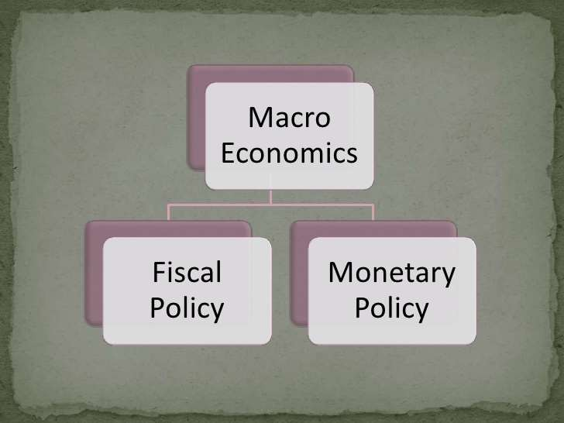
Introduction

Slide 4

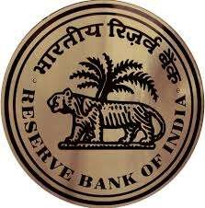
Monetary Policy
A programme of action undertaken by the monetary authorities – The central bank (RBI) to control and regulate the SUPPLY OF MONEY with the public and Flow Of Credit with the view of achieving MACROECONOMIC goals

Slide 5
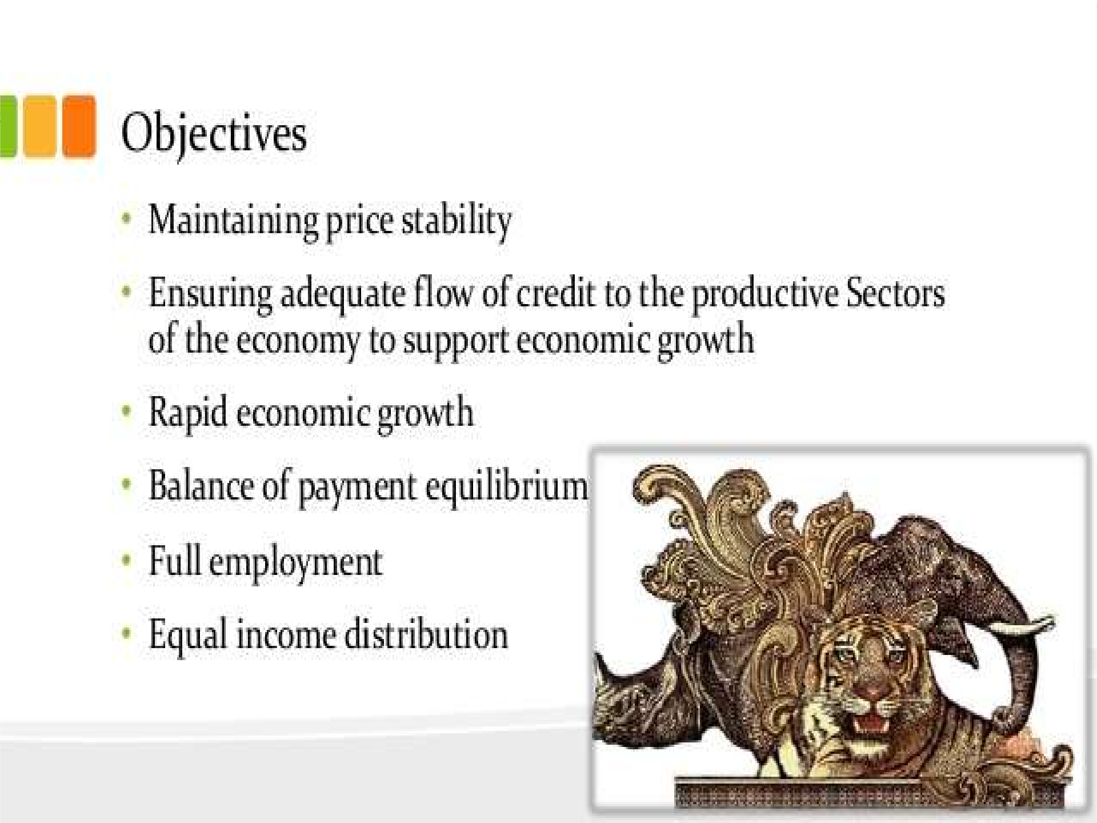


Slide 6

Tools of Monetary Policy in India
Bank Rates
Repo Rate and Reverse Repo Rate
CRR
SLR

Slide 7


Bank Rate
Bank Rate is the rate at which RBI allows finance to commercial banks.
Any upward revision in Bank Rate by central bank is an indication that commercial banks should also increase deposit rates as well as Prime Lending Rates.
This any revision in the Bank rate influence interest on your deposits and also an increase or decrease in your EMI.
At present Bank Rate: 8.5%

Slide 8


Repo Rate and Reverse Repo Rate
Repo Rate is the rate at which RBI lends money to commercial banks.
At present Repo Rate: 7.5%
Reverse Repo Rate is the rate at which RBI borrows money from the commercial banks.
At present Reverse Repo Rate : 6.5%

Slide 9


Cash Reserve Ratio
Cash Reserve Ratio is the amount of funds that the banks have to keep with the RBI.
The CRR is basically to secure solvency of the banks.
The present CRR: 4%

Slide 10


Statutory Liquidity Ratio
Statutory Liquidity Ratio (SLR) is the Indian government term for reserve requirement that the commercial banks in India require to maintain in the form of gold, cash or government approved securities before providing credit to the customers.
SLR is maintained in order to control the expansion of bank credit.
The present SLR: 21.5%

Slide 11



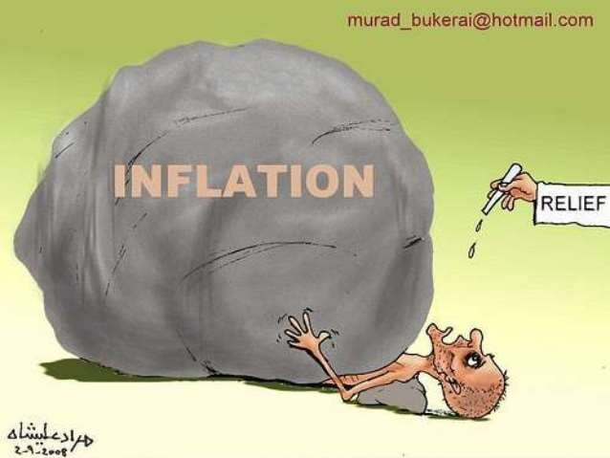
Inflation
Inflation is state in which the value of money falling and the prices are rising.

Slide 12



