Slide 1
PERSONALITY DEVELOPMENT
Dr. Sadhna
Associate Prof. in Economics
SMS Khalsa labana College
Barara, Ambala

Slide 2
PERSONALITY
Personality development is a build up of thoughts action and behaviour
When we say that someone has a "good personality" we mean that they are likeable, interesting and pleasant to be with.
People saw your outer Appearance and beauty what what matters a lot is your inner Beauty
In fact, approximately 85 percent of your success and happiness will be a result of how well you interact with others

Slide 3
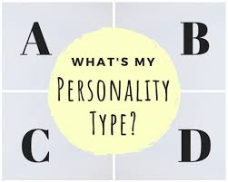
PERSONALITY TEST

Slide 5
TYPE OF PERSONALITY

Slide 6
TYPE OF PERSONALITY
HIMA DAS
MAGATANA GANDHI

Slide 7
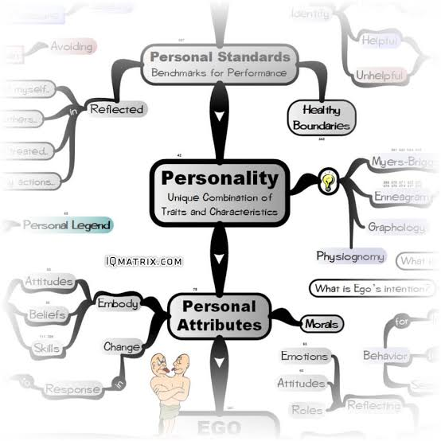
ATTRIBUTES
GOOD PHYSIQUE
Pleasing manners
Personal and Professional Integrity
Thoughtfulness
Trustworthiness
Reliability
Good control over mind and body
Health
Body language
Eye contact
Facial ex
Position of hand, arm and posture
Communication
Reading makes a full man
Always speak words of kindness
Time management

Slide 8
PSYCHOLOGICAL ATTRIBUTES

Slide 11
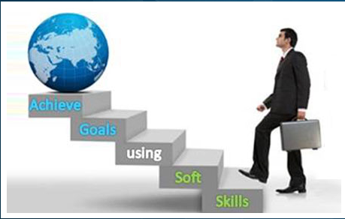
FEATURES
IDENTIFICATION ENDURING CHARACTERS
IDENTIFY
SOME HAVE ATTRACTIVE PERSONALITY
SOME DON’T HAVE
WORK ON INNER BEAUTY
PEOPLE SAW YOUR OUTER BEAUTY BUT WHAT
MATTERS IS YOUR INNER BEAUTY
BUT WHAT MATTERS A LOT IS YOUR INTERNAL
ARRANGE DEVELOPING SELF CONFIDENCE
TALKING STYLE
BUILD CONFIDENCE
CONFIDENCE BUILDS PERSONALITY BOTH OUTER AND INNER

Slide 12
KNOW YOUR PERSONALITY

Slide 13
TIME MANAGEMENT

Slide 14
ANGER MANAGEMENT

Slide 15
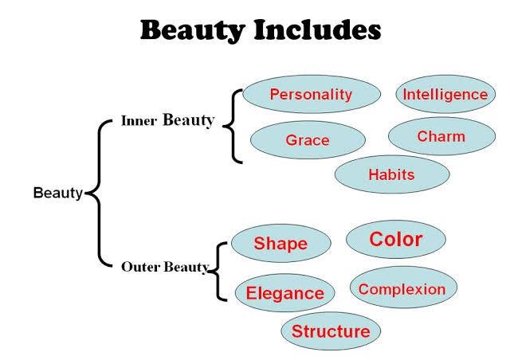
HOW TO IMPROVE YOUR INNER & OUTER BEAUTY

Slide 16
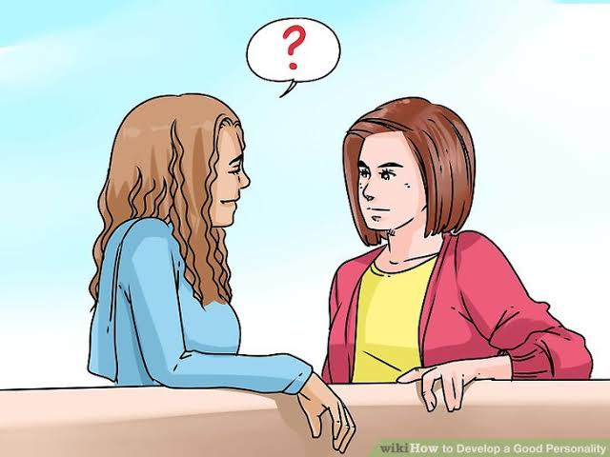
WORK FOR SOCIETY – GOOD BEHAVIOUR & BODY LANGUAGE

Slide 17
BEAUTY TIPS
Attractive lips – Speak words of kindness
Lovely eyes – Look out the good in people
Figure – share your food with hungry
For Praise – Walk with knowledge you will never walk alone
If you need a helping hand
always give one to others and you will find there is always god to give you a helping hand

Slide 18
Positive thinking
Negative thinking causes problems and positive thinking gives solutions. The Power of Positive thinking
Draw a picture of successful persons
Cancel your negative thoughts
Do not copy others blindly
Get a competent counslor to help you
Practice the sentence – I can do it
Make the true estimate of your ability
God is your creater

Slide 19
POSITIVE THINKING

Slide 20
LEADERSHIP
Clean vision of yourself, family and organisation
Have faith in your morals and values
Utilize your full strength
Set definite goals
Lead and motivate others
Improve your communication skills
Always take the best initiative
Always be punctual

Slide 22
TIPS
Don’t waste time
Be willing to do all jobs whatever is assigned
Be cheerful
Be helpful
Honesty describe the trails life
Donot laugh at people who are in a difficult time
Know your trails and stregth

Slide 23
Characters
Be polite speak sweetly
Be careful about what we say for others
Keep away from lies and fraud
Adjust with others
Believe in Healthy competition
Try to get rid of your bad habbits if you have any
Make others feel good in your company because of your positive attitude
Always spread light/positivity

